Slide 1
Introduction to HL7 FHIR
May, 2012
Grahame Grieve
Ewout Kramer
Lloyd McKenzie

Slide 2
Current version
This presentation will be updated as FHIR evolves
The current version of the presentation can be found here:
http://gforge.hl7.org/gf/project/fhir/docman/?subdir=404

Slide 3
Outline
Why FHIR?
FHIR Background
What is FHIR?
Methodology
Tooling & Migration
Next Steps

Slide 4
Who are we?
Grahame Grieve
Australian, health interoperability – v2, v3, CDA, etc. tools, products, specifications, governance… http://www.healthintersections.com.au
Ewout Kramer
Chief architect & Manager R&D Furore
Dutch, architect in healthcare, messaging, data modeling, software development http://www.furore.com
Lloyd McKenzie
Canadian, data modeling, terminology, tooling, conformance
http://www.gordonpointinformatics.com

Slide 5
Caveats !
FHIR is a work in progress
Specification has been looked at by many people, but not subjected to ballot or any official review
FHIR continues to evolve
Much of what we tell you could change, at least somewhat, before it is stable

Slide 6
Why FHIR?

Slide 7
FHIR is necessary because
V3 is too hard
Documents aren’t enough
V2 needs a transition path
There are new markets and HL7 needs something to offer
The world has evolved

Slide 8
V3 is too hard?
V3 puts needs of the modeler before the needs of the implementer
How we publish – targeted to reviewer
What we publish – rationale, derivations, abstractions
Content of instances – cluttered with semantic structures
Learning curve is too steep
Have you looked at a normative edition lately?

Slide 9
V3 is too hard? (cont’d)
UV specs are too abstract, too big or both
Implementers/projects must significantly constrain to allow implementation
Barrier to adoption & interoperability
Tools to develop, maintain & constrain are all custom
Even newer tools build on top of “off-the-shelf” UML are heavily customized
Wire format is unstable
In addition to changes between jurisdictions, wire format can change between versions

Slide 10
V3 is too hard - result
Development process is slow
3-7+ years for a domain to become normative
Poor market penetration
Very little up-take without major sponsorship (and investment) by large projects
V3 messaging is non-starter in the US, despite massive activity & investment in healthcare interoperability
With exception of CDA and one or two other specs, zero direct (wire-format compatible) implementation of HL7 v3 specs

Slide 11
So – I should throw away v3?
No!
V3 is still useful
Foundation for FHIR under the covers
Couldn’t do FHIR if we hadn’t done v3 first
V3 has been used successfully in environments where needed implementer support resources can be provided
V3 and CDA will continue to be supported for as long as the implementation community wishes, just like v2
FHIR is “bleeding edge”, so many projects may wish to stick with current directions for at least the next few years.

Slide 12
Documents are not enough
“But what about CDA?”
CDA has many lessons to teach us:
Wire format stability is essential
Provide an extension mechanism
Though CDA extension is quite problematic
Text (human-to-human) interoperability is critical stepping stone
Breaking data into “chunks” is helpful
That said:
CDA is successful, but in many cases in spite of rather than because of v3

Slide 13
Documents are not enough
Good semantic representation still requires a good knowledge of the RIM
Lots of templates with poor or non-existent semantics
Wire format overly cluttered
Implementers tolerate it because there’s nothing better
Strong push for things like Green CDA
Interoperability dependent on consistent templates
Roll-your-own CDA instance non-interoperable except as text
While extensibility exists, its use is highly frowned upon
Extensions require pre-processing and break schemas

Slide 14
V2 needs a transition path
V2 implementations will be around for another 20+ years
Many of them 2.3 and 2.3.1 ☺
However, v2 does not provide a modern platform for internal processing and manipulation of healthcare data
And in the eyes of most implementers, nor does v3
We need something the v2 implementers can start using internally, and possibly eventually migrate to using for exchange

Slide 15
New Markets
If someone is building a new iOS healthcare app (and thousands are), what standard do we point them at?
If someone wants to provide a cloud based health app that integrates with social networks, what standard should they use?
If a vendor wants to provide a simple to use standards based API to cloud based health integration services, what standard should they extend?
If a government wants to implement a national EHR, who should they talk to?

Slide 16
The world has evolved
And HL7 needs to too . . .
V3 was first conceived almost 15 years ago, and leveraged approaches older than that
XML was new
Schema didn’t even exist
The technology and approach of interoperability has changed since then
We need to get current or risk becoming irrelevant

Slide 17
Fhir Background

Slide 18
Fresh Look
In January 2011, the HL7 Board initiated a project called “Fresh Look”
Mandate was to identify “what would we do if we were to revisit the healthcare interoperability space from scratch?”
At the May 2011 WGM, there was an “official” meeting of the Fresh Look taskforce
Didn’t accomplish a whole lot
There was also an “unofficial” meeting that took over an evening RIMBAA session and was broadly attended
Much of the discussion was focused on HL7 v3 pain points

Slide 19
HL7 v3 has failed?
One of the most controversial things stated at the session was “HL7 v3 has failed”
Rationale is mostly covered above in the “Why FHIR” section above
(and note the caveats about not abandoning v3)

Slide 20
So what should HL7 do?
The unofficial meeting didn’t really get to the point of addressing solutions
No obvious ones in the room at the time
Strong feeling that “v3 has lots of good stuff in it”
No desire to abandon the good work that has been done
Definitely a need to do things better
From this meeting the seeds were planted for RFH/FHIR

Slide 21
RFH/FHIR
Prior to Sept. 2011 meeting, Grahame Grieve posted a number of articles on his blog discussing some of the challenges (and successes) of HL7 v3
Culmination was release of first draft of RFH – Resources for Healthcare
Not a complete specification
Based on extremely well-regarded CRM interface by a company called Highrise
But complete enough to show roughly how it would work, including example instances and model design
Reviewed at the Sept. 2011 WGM and met with a very positive response

Slide 22
ast
(to design & implement)
ealthcare
nteroperability
esources

Slide 23

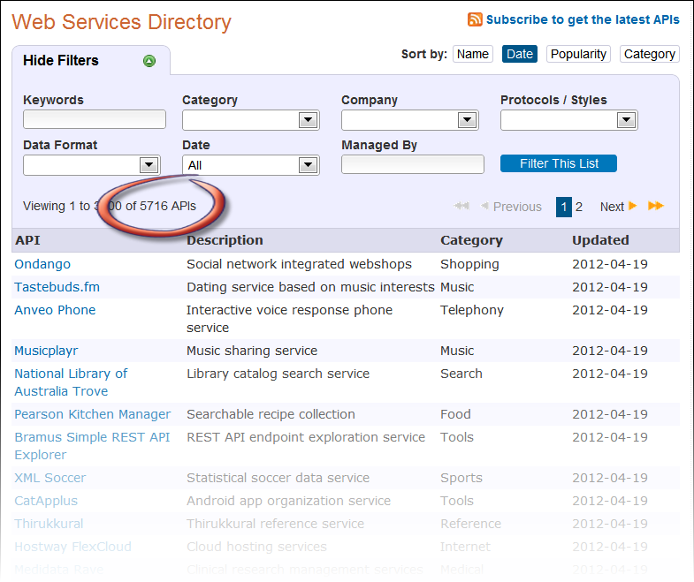
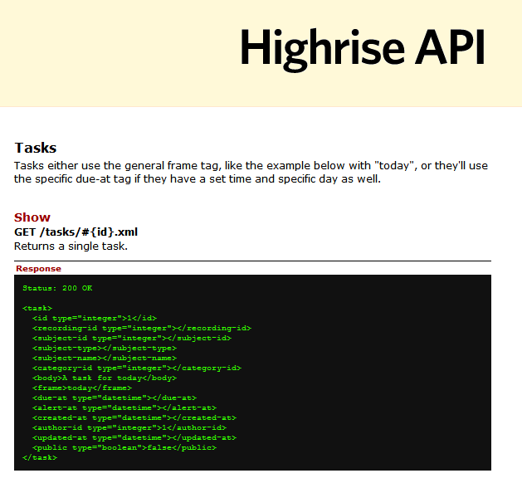
Highrise

Slide 24
RFH or FHIR?
The name on the original proposal was RFH
Duplicate of a name of a WHO project
Web domains already taken
Effort by HL7 marketing to come up with a new name
With v3, by the time marketing looked at the name, it was already too engrained
Selected name: FHIR – Fast Healthcare Interoperability Resources

Slide 25
Transition to HL7
In March 2012, HL7 Board of Directors agreed to a transfer of FHIR IP to HL7
Condition is that first normative edition of FHIR be made available for free to all implementers
Content now hosted on HL7 SVN under its own g-Forge project
Publication under HL7 URL is in progress
http://www.hl7.org/fhir

Slide 26
What is FHIR?

Slide 27
What is FHIR?
Fast Healthcare Interoperability Resources
Pronounced “FIRE”
As significant as change from v2 to v3
Won’t be marketed as “v4” though
New artifacts
New methodology
New tools
New publishing approach
Still built on RIM, vocab & datatypes, but more hidden

Slide 28
FHIR premises
Design for the 80%, not 100%
Only include data elements in the artifacts if 80% of all implementers of that artifact will use the data element
Allow easy extension for the remaining 20% of elements
which often make up 80% of current specs
Vocabulary approach to extension definition
Focus publication on documenting what the implementer needs, not what the modelers thought or designers need to remember

Slide 29
FHIR premises (cont’d)
Be concise – every word written is a word that must be read 1000s of times
Wire format (XML) rules – no ITSs – we design the physical, not the abstract
Wire format stability
Names & paths are the same – likely forever
Retain rigor of HL7 v3, but don’t force implementers to look at it

Slide 30
FHIR Basics
Build around the concept of “resources”
Small, discrete concepts that can be maintained independently
Aligns with RESTful design philosophy
Similar to the concept of CMETs, but there’s only *one* model per resource
Each resource has a unique id
Resources are smallest units of transaction

Slide 31
RESTful Interfaces
Resources can be used with a simple RESTful interface
Predictable URL
HTTP based atomic transactions for CRUD Operations
Delete may not be honored and is not a true delete
Use with a RESTful framework is not required
Can aggregate resources into documents and send as a group
FHIR provides a classic event based messaging framework
Can use resources in custom services / SOA as desired

Slide 32
FHIR Basics (cont’d)
More sophisticated flows (than CRUD) can be defined called “transactions”
Adds additional metadata to track who made changes, etc.
Or can use messaging/services
Formally defined conformance profiles
Mandatory for RESTful interface
Defines what resources are supported, what elements, what extensions, what transactions

Slide 33
FHIR Basics (cont’d)
Each resource is modeled using developer friendly XML
XML does not reflect RIM-based modeling
No classCodes, moodCodes, etc. visible
Strong ontology behind the scenes that does link to RIM and vocabulary
Uses a variant of the ISO datatypes
Simplifies some things (by moving them out of datatypes)
Adds support for simplifications such as human-readable dates, human-readable ids

Slide 34
FHIR Basics (cont’d)
Built-in extension mechanism
Extensions are defined using name, value, link-point
Name is tied to robust terminology with full RIM modeling
Link point identifies what element of the base resource or other extension the extension “attaches” to
Idea is the elements used by 80% of implementers (in code of 80% of implementation solutions) are part of the base resource.
All other elements are handled as extensions
Extension is not a “dirty word” in FHIR
Wire format remains stable, even as extensions occur

Slide 35
FHIR Basics (cont’d)
Full support for textual mark-up
In v3, only CDA provides for free-text mark-up for all elements. Messaging focuses on discrete data.
With FHIR, all resources, as well as all resource attributes have a free-text expression, an encoded expression or both
Conformance controls whether discrete data is required or not
Ensures that FHIR can support the human-readable interoperability delivered by CDA
Mark up is xhtml directly

Slide 36
New artifacts
New datatypes model
Resources
Conformance profiles
Messages
Documents

Slide 37
New datatypes model
Simplified
Much complexity moved into extensions
Content is still traceable to ISO datatypes
Significant interest by OpenEHR in harmonizing with their datatypes
openEHR can’t adopt the same data types, but mapping will be very close

Slide 38
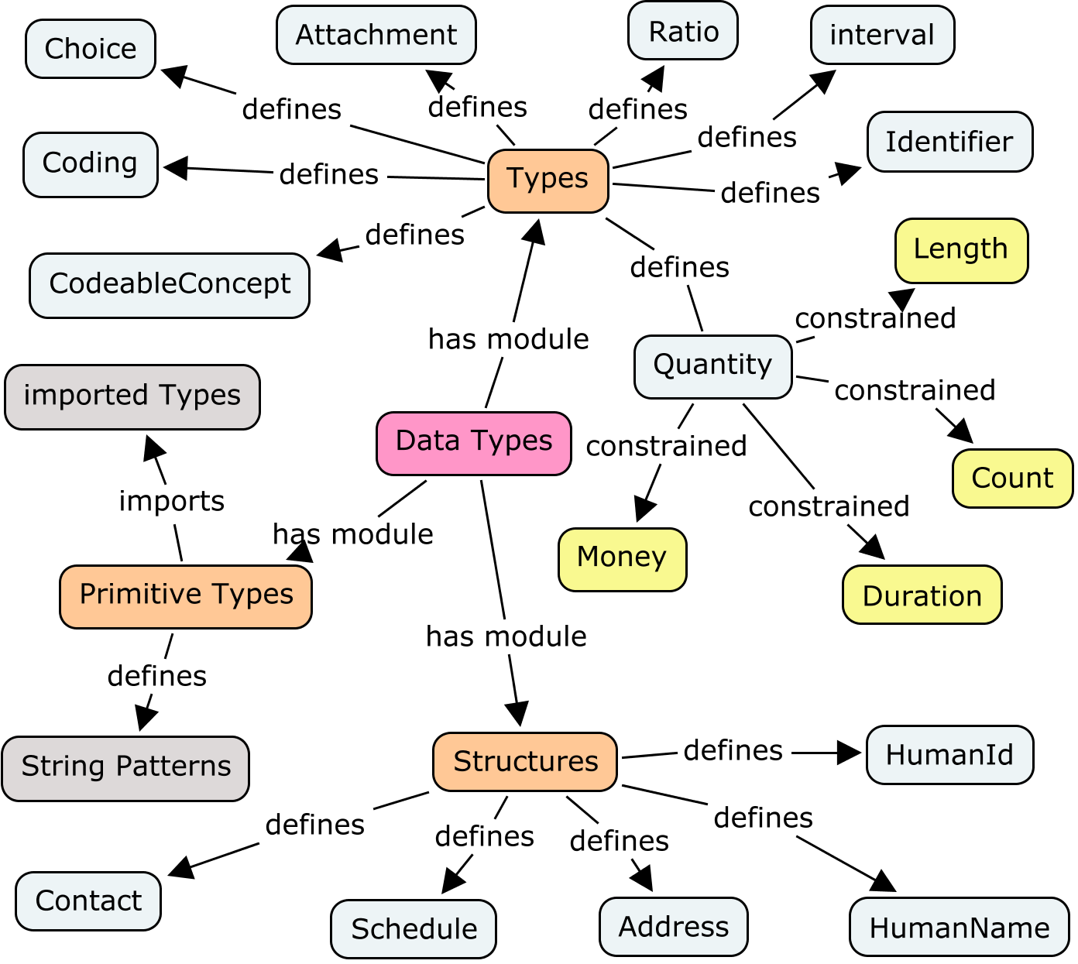
New datatypes model

Slide 39
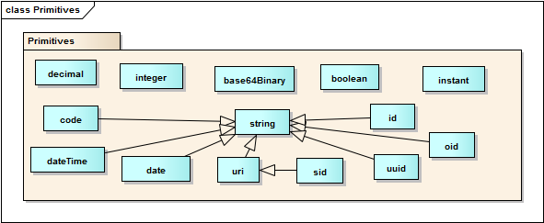
Datatypes primitives
Based on xml schema primitives

Slide 40
Example – CD datatype
ISO
Code, code system, code system name, code system version, value set id, value set version, coding rationale, updateMode, flavorId, nullFlavor, controlAct root & extension, validTime low and high
displayName with language and translations
originalText with mediaType, language, compression, integrityCheck, thumbnail, description, translations, reference (can be text, video, whatever)
Translations (most of same info as code)
Source code

Slide 41
Example – CD datatype
FHIR
Code, code system, code system name, code system version, value set id, value set version coding rationale, updateMode, flavorId, nullFlavor, controlAct root & extension, validTime low and high
displayName with language and translations
originalText with mediaType, language, compression, integrityCheck, thumbnail, description, translations, reference (can be text, video, whatever)
Translations (most of same info as code)
Source code

Slide 42
Example – CD datatype
“But wait, I need property x, what do I do?”
Answer: Use extensions.
You can send as much information with FHIR as you can with the ISO datatype.
All of the uncommon stuff – those things most implementers don’t need – is handled as extensions.

Slide 43
Resource
Primary artifact
Based on REST concept of resources
Like CMETs, but only one for each concept
no ‘flavors’ like contactable, universal
All defined by HL7
100-150 total for all of healthcare. Ever
Can be maintained separately
Examples:
Person, Patient, Prescription, etc.

Slide 44
Resource elements
Resources are defined as an XML structure based on desired wire syntax
Heirarchy of elements
Each element has
a name
either a datatype or nested elements
optionality
cardinality
All collections are nested in a containing element
Definition
RIM mapping

Slide 45
Resource representations
Each resource is published with several views covering different aspects
UML diagram
Simple pseudo-XML syntax
Vocabulary bindings
Notes
Search Criteria
Data dictionary
Example instance
Schema

Slide 46
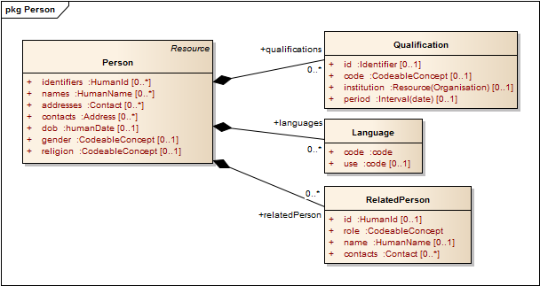
Example - Person

Slide 47
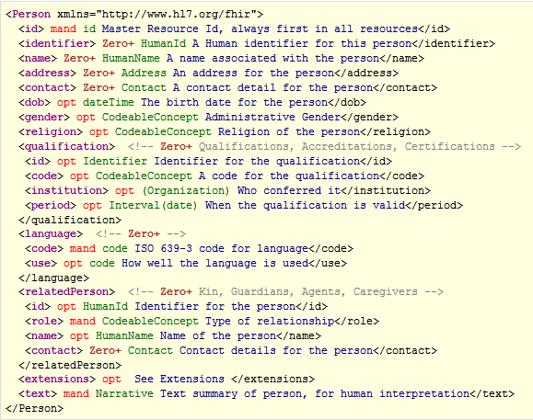
Example - Person

Slide 48
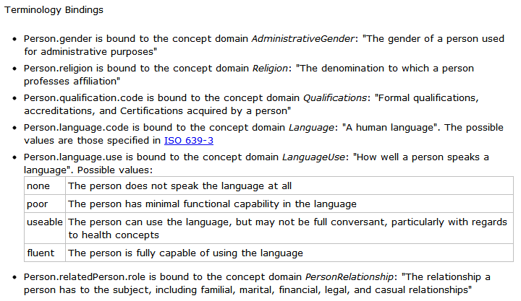
Example - Person

Slide 49
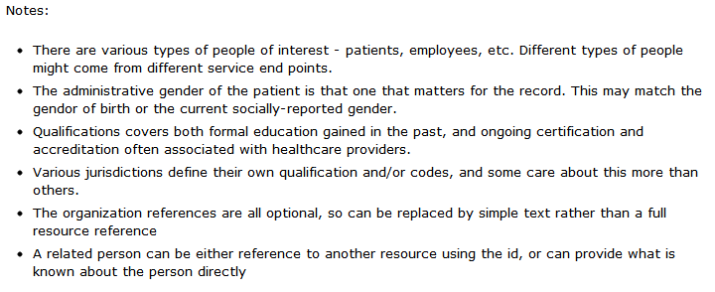
Example - Person

Slide 50
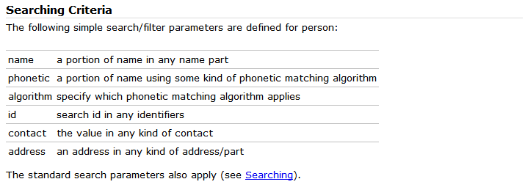
Example - Person

Slide 51
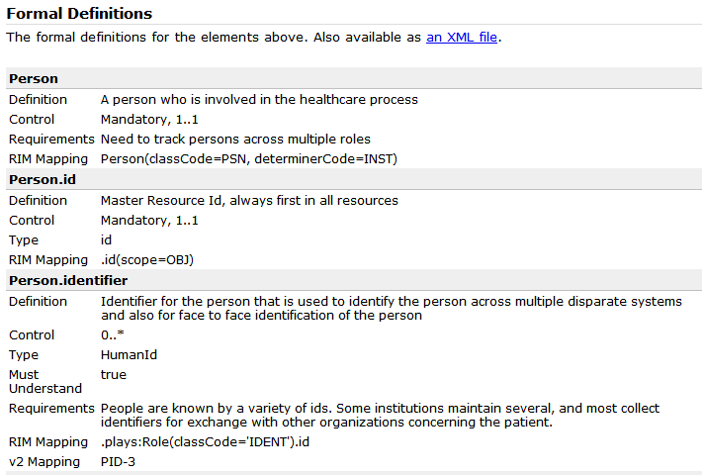
Example - Person

Slide 52
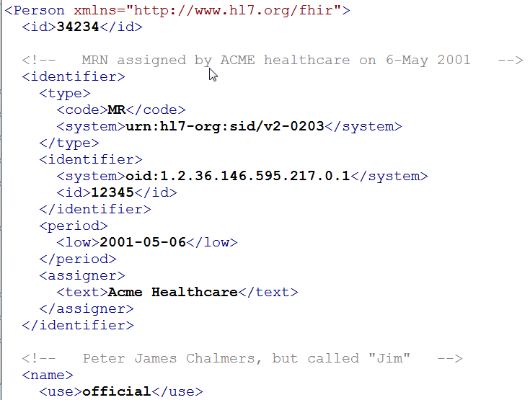
Example - Person

Slide 53
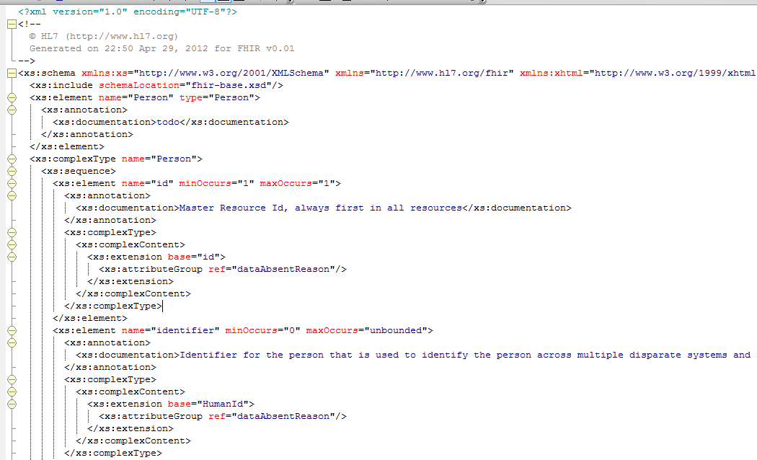
Example - Person

Slide 54
Methodology

Slide 55
Messages
Collection of resources sent as a result of some real-world event intended to accomplish a particular purpose
Event Codes & Definitions, like HL7 v2
Some message profiles will be defined by HL7, others by projects or implementers
Includes a “Message” resource, similar in purpose to Message wrapper and MSH segment
May have associated behavior
Can be conveyed via MLLP, SOAP or other means

Slide 56
Documents
Collection of resources grouped for persistence and attestation
Some document profiles will be defined by HL7, others by projects or implementers
Includes a “Document” resource, similar in purpose to CDA header

Slide 57
Methodology
Initial focus will be on creating resources
Challenge will be determining what fits in the 80%
After that, vetting extensions and helping define profiles on resources to meet specific use-cases in different paradigms (messaging, documents, services)
DAMs may still exist, but will be less essential
Resources are already in user terms & carry synonyms
Balloting done like v2 – all resources balloted at once

Slide 58
Methodology (cont’d)
No more design by constraint
Extensions will be essential. Most implementations will use them
Possibility HL7 will get involved in vetting extensions through voluntary submission process
Dynamic model:
Lightweight general model – event codes a la v2
Committees free to define services that use Resources
Ideal base for templates – consistent wire format, lots of re-use
Some of the CIMI trials will be using FHIR

Slide 59
Methodology (cont’d)
MIF: there is a formal object model for FHIR definitions
Much simpler, private to tooling
All localizations handled as extensions
If you customize the XML, you’re non-conformant. Period.
HL7-defined/approved extensions will not migrate to “core” XML
Other extensions could migrate, though it would be rare

Slide 60
Key differences
RIM mapping is important but not central to design
Should still be iterative feedback based on ramifications of RIM modeling to ensure clear definition, appropriate selection of elements, etc.
Much greater pressure to exclude requirements, rather than building to support anything and everything.
No proliferation of models (resources)
On the order of 100 total, and 20-30 of those will be edge cases like claims, clinical trials.
Most general clinical systems will deal with ~50 max
Profiles may proliferate
Everything driven by business names, not RIM names

Slide 61
Similarities
Terminology
Simpler façade over core principles
Still complex & hard
RIM mapping still required, though possibly more centralized and with better QA
Still challenges finding good definitions
Maybe greater, due to focus on minimal word count
Documents, messages & services still exist
Much better chance for consistency of data

Slide 62
Points of interest
Can’t change cardinality. If you need to, you define a new element, not change the old one
Any singular elements that could repeat in the RIM must clearly define which repetition is selected
REST is really popular, but, depending on technology stack may not scale in any sort of non-trusted environment
Whether REST makes sense will depend on implementation environment
Don’t need REST to use FHIR

Slide 63
Governance challenges
Who owns what resource?
When do we create a new resource?
Need to avoid overlap
Existing problem becomes more important
What fits in the 80%?
How much time to we give to FHIR vs. traditional v3?
When faced with a use-case, do we use documents, messages, services or REST?
Can do all of the above, but multiple solutions could have interoperability consequences

Slide 64
Tooling and Migration

Slide 65
Tools
No need for v3-generator
No need for RMIM designer
Unlikely to need new Instance Editor as most rules will be Schema or Schematron enforced.
Internal tooling:
Some v3 tooling still needed
Rosetree (or some other RIM & Vocab browser still needed)
Pub-DB will likely go away, though exact evolution depends on dynamic model decisions

Slide 66
Tools (cont’d)
Generation tool built in Java. Anyone can build the publication at will
Source files maintained as xml spreadsheets
Easy Editing
Easy source control & Easy merging
Easy importing into whatever
May get more sophisticated tooling over time (e.g. vocab support)
Will likely need tooling to help with mapping and particularly with defining conformance profiles
Need registry tool to manage registered extensions too

Slide 67
Publishing
Current version at http://www.hl7.org/fhir
Implies a new & different ballot publication process
FHIR is balloted as a single spec like v2
Instance example mandatory
Publication automatically generated from source files – by anyone
Schemas
HTML
Validation of instance example
reference implementations: Java, C#, others

Slide 68
Migration
Realistically, we don’t expect anyone to migrate existing interfaces any time soon.
Initial adopters will be green-field, new technology
FHIR may see use behind the scenes in v2 systems before it sees use over the wire

Slide 69
Migration – v2
Already have an integration engine that supports translation between v2 and FHIR
Resources map to segments reasonably well
As always, the challenge with v2 mapping is the variability of v2 interfaces
“Common” mappings can be created, but they won’t be one size fits all

Slide 70
Migration – v3
V3 migrations should be more straight-forward as semantics are clear
Migrations will need to happen based on templates and realm constraints rather than international specs in most cases
Round-trip transforms are possible
Which get targeted first will depend on implementer desires

Slide 71
What next?

Slide 72
Follow-up
Review content on the FHIR site
http://www.hl7.org/fhir
Provide feedback on the wiki
Numerous FHIR-related sessions during the week
Attend the Q4 tutorial (or e-mail for a copy of the slides)
Consider drafting a PSS for your committee to start creating FHIR resources

Slide 73
FHIR this week
Several quarters scheduled for FHIR-related topics, including:
ITS: XML, JSON, REST - Wed Q1-Q2
RIMBAA: - Architecture of resources, example implementations Thurs Q1
Others TBA
Refer to Grahame’s blog:
http://www.healthintersections.com.au

Slide 74
Contacts
FHIR Mailing list: fhir@lists.hl7.org
Grahame: grahame@healthintersections.com.au
Ewout: e.kramer@furore.com
Lloyd: lloyd@lmckenzie.com

Slide 75
Questions & Answers

Slide 76
Q&A
The following slides were not part of the tutorial presentation, but summarize questions asked during or following the presentation.
Note: Some comments were applied directly as updates to slides rather than included in this section

Slide 77
Q&A
Is there an automatable conversion from v3 to FHIR?
No. Design process & though process is different and requires human intervention
Once FHIR resource design is complete, possible to transform between FHIR and RMIMs if desired
Will you create a template PSS for committees looking at doing FHIR resources?
Yes

Slide 78
Q&A
What’s the timeline?
Initial methodology ballot this summer
DSTU first ballot of initial set of resources this fall
In theory could be done DSTU of implementable chunk of FHIR in 2 years
In practice, dependent on work of committees

Slide 79
Q&A
What’s the overlap between FHIR and CIMI?
Solving different problems, with different scopes, intents and organisational priorities
They overlap. Many people, including the leads for CIMI and FHIR would like them to be consistent
Don't know at this time what that would actually mean, and neither project is willing to wait for the other
Will continue to have interaction and cross-pollination in the hope that this prevents the projects from becoming inconsistent

Slide 80
Q&A
What’s the relationship between FHIR and CDA?
CDA can be expressed in FHIR
When/if that migration will happen will be up to Structured Docs (and possibly influenced by TSC)
For now, need to see how quickly FHIR moves wrt CDA R3

Slide 81
Q&A
Can implementers start doing FHIR before it’s “official”?
Yes. And some already are
Take the idea and run with it. Try things. But be aware that you can’t claim it’s “standard” and that retrofitting to become standard may be necessary later

Slide 82
Q&A
Are you really going to never move extensions into core?
Point of contention
Costs to doing so and not doing so
Even if we choose not to, creating a new replacement resource (e.g. Person2) is possible
Will revisit as we get closer to normative and have more implementer opinion

Slide 83
Q&A
Is FHIR compatible with the NIEM?
That will be one of the source models resources will be designed taking into consideration.

Slide 84
Licensing and Attribution
This presentation is licensed under the Creative Commons Attribution Non-commercial Share Alike 3.0 license
Details can be found here:
http://creativecommons.org/licenses/by-nc-sa/3.0/
The background image is sourced from quality3dmodels.net under the same license terms.

